Slide 1
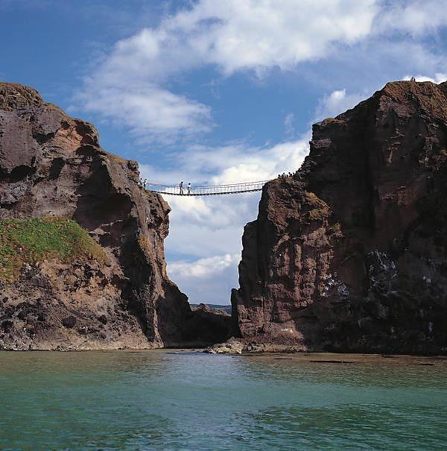
Graph Querying Meets HCI: State of the Art and Future Directions
Sourav S Bhowmick Nanyang Technological
Univ
Singapore
Byron Choi
Hong Kong Baptist Univ
Hong Kong
Chengkai Li
The Univ of Texas at Arlington
USA

Slide 2
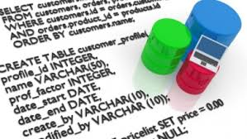
First Generation Data Management
Driven primarily by enterprises to store and query data
Developers: Build DB & applications
Business analysts: Pose queries
DB admin: Tune & monitor performance
End users: Generate data, query data
Performance
Functionality
Abadi et al. The Beckman report on database research. Commun. ACM 59(2): 92-99 (2016)

Slide 3
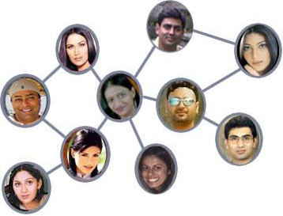
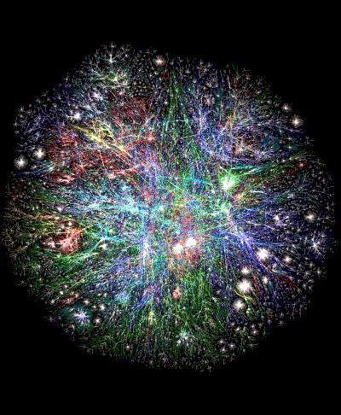
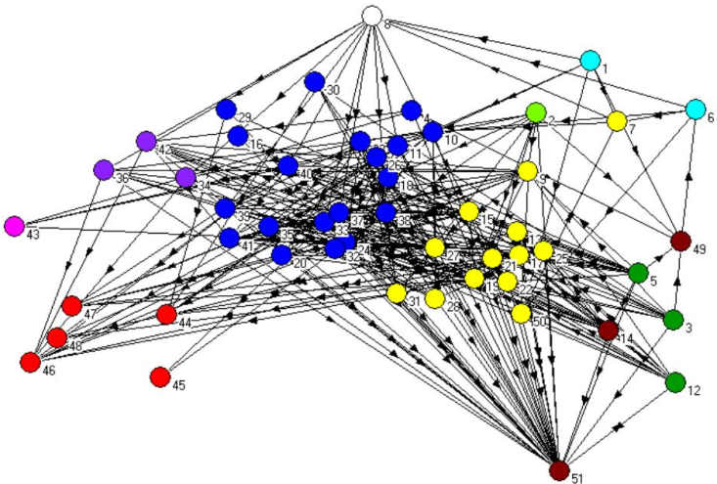
Emergence of Network Data
Social network
Ecological network
WWW
Human PPI network

Slide 4

Querying Graphs
Graphs
A large set of small/medium-sized graphs
A large graph/network
Massive graph
Query Formulation
Formal query language
SPARQL, Cypher
Query Processing
Efficient algorithms and optimization techniques to process queries “quickly”

Slide 5




Fifth Generation Data Management
Data management has democratized
End Users: Generator, processor, and consumer
DB illiterate
Increasingly complex data and computation
Resides everywhere
biologist
social scientist
chemist
journalist
Abadi et al. The Beckman report on database research. Commun. ACM 59(2): 92-99 (2016)

Slide 6
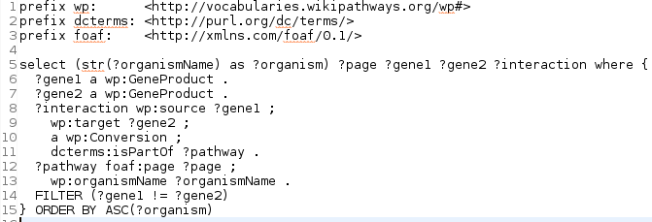

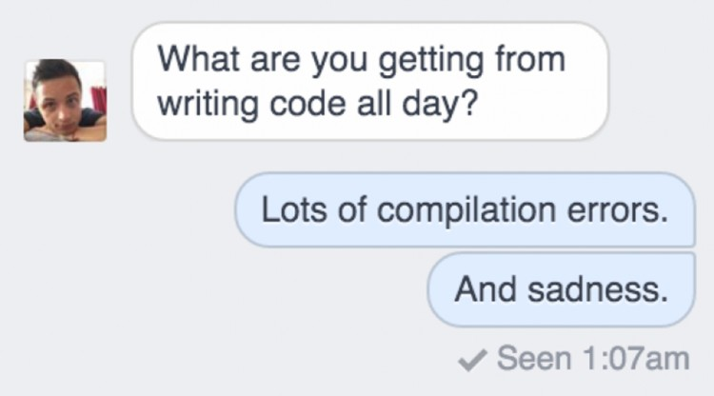
Querying Graphs: The First Generation Approach

Slide 7

Reality Check!
Reality
Thirty years of research on query languages can be summarized by: we have moved from SQL to XQuery. At best we have moved from one declarative language to a second declarative language with roughly the same level of expressiveness. It has been well documented that end users will not learn SQL; rather SQL is notation for professional programmers.
The Lowell Database Research Self-Assessment,
Communication of the ACM (May 2005)

Slide 8

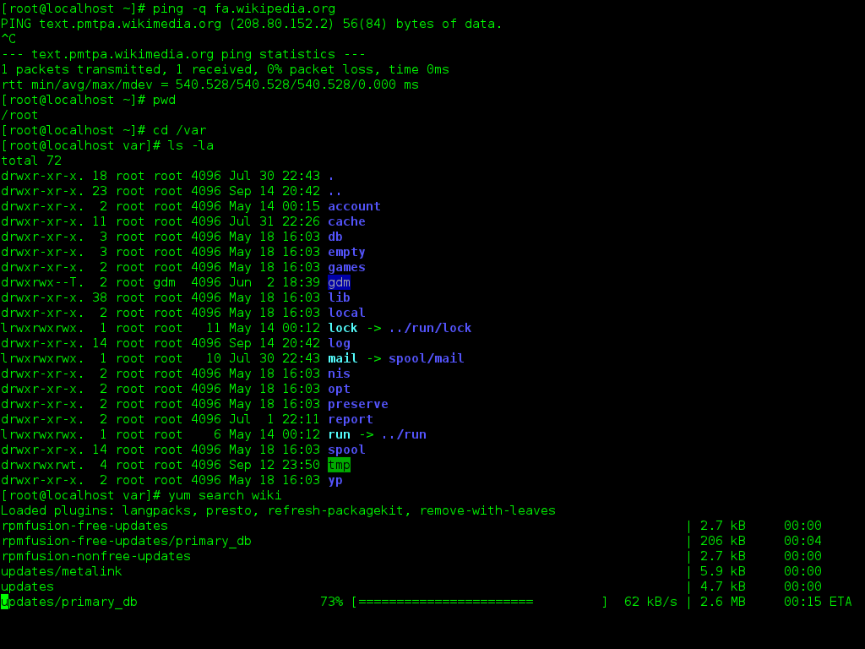
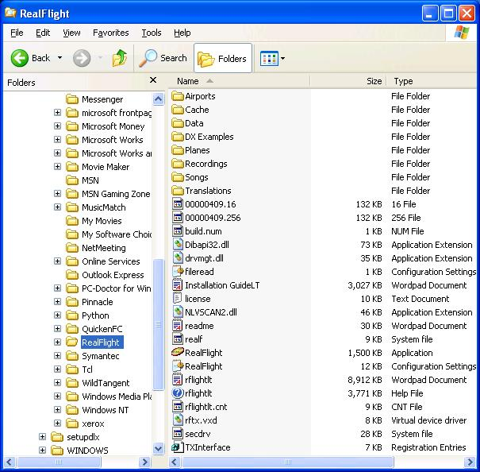

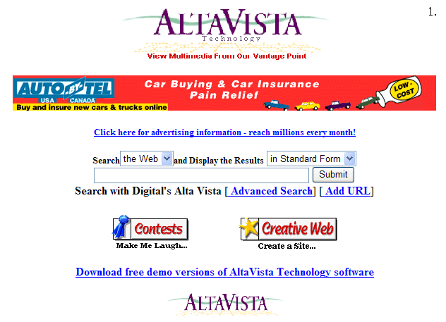

Usability Matters!
Data-driven Software
Usability
Functionality
Performance

Slide 9
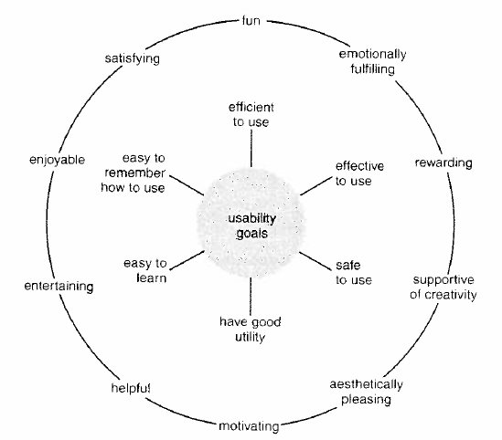
Usability [Preece et al.]
What is it?
How well users can use the system’s functionality
Dimensionality
Learnability: is it easy to learn?
Efficiency: once learned, is it fast to use?
Memorability: is it easy to remember what you learned?
Errors: are errors few and recoverable?
Satisfaction: is it enjoyable to use?

Slide 10
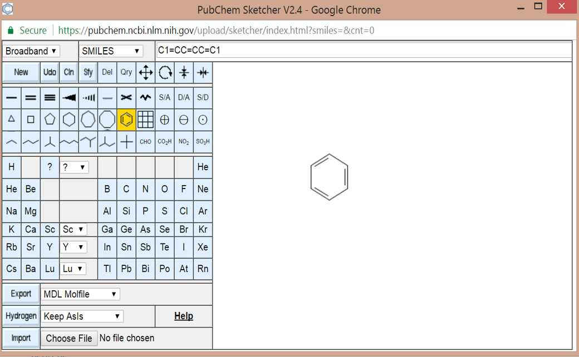
Visual Graph Querying
Usability and good UI design are closely related
Studying and improving usability is part of Human-Computer Interaction (HCI).

Slide 11
Different Worlds
Usability
Functionalities
DB World
Performance
Functionalities
Performance
Usability
HCI World

Slide 12


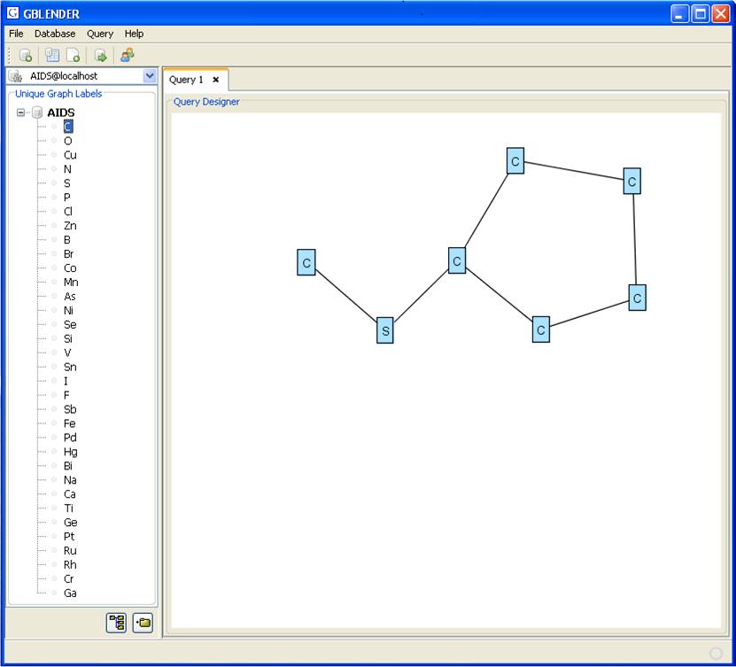
The Chasm for 40+ Years

Slide 13

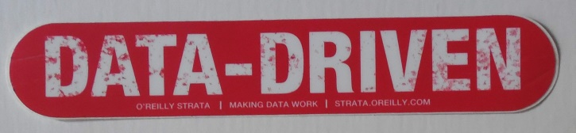
Graph Querying Meets HCI
HCI-DRIVEN
HCI
DB
`

Slide 14
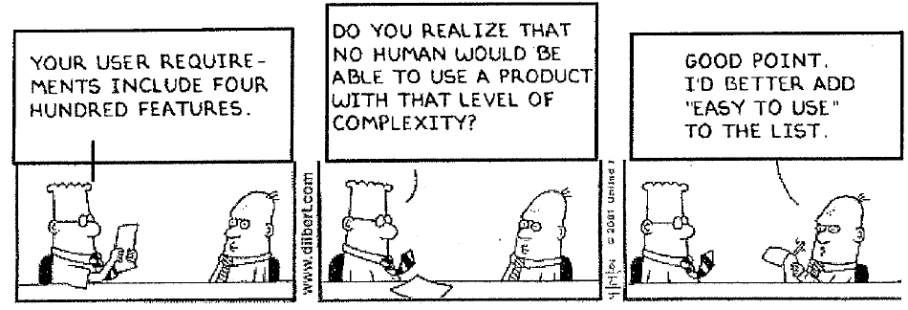
Lessons from HCI: Schneiderman’s 8 Golden Rules
Strive for consistency.
Give shortcuts to the user.
Offer informative feedback.
Make each interaction with the user yield a result.
Offer simple error handling.
Permit easy undo of actions.
Let the user be in control.
Reduce short-term memory load on the user.
How do these “HCI lessons” impact visual graph querying?

Slide 15
Tutorial Overview
Strive for consistency
Visual Interfaces for Graph Queries
Visual Graph Query Formulation & Guidance
Visual Action-aware Graph Query Processing
Query Results Exploration & Visualization
Give shortcut to the user
Informative feedback
Simple error handling
Make each interaction with the user yield a result
Make each interaction with the user yield a result
Let the user be in control

Slide 16

Visual Interfaces for Graph Queries
Next

Slide 17
Visual Graph Query Interfaces
Manual
Data-driven
Functionalities
vs
Aesthetics

Slide 18
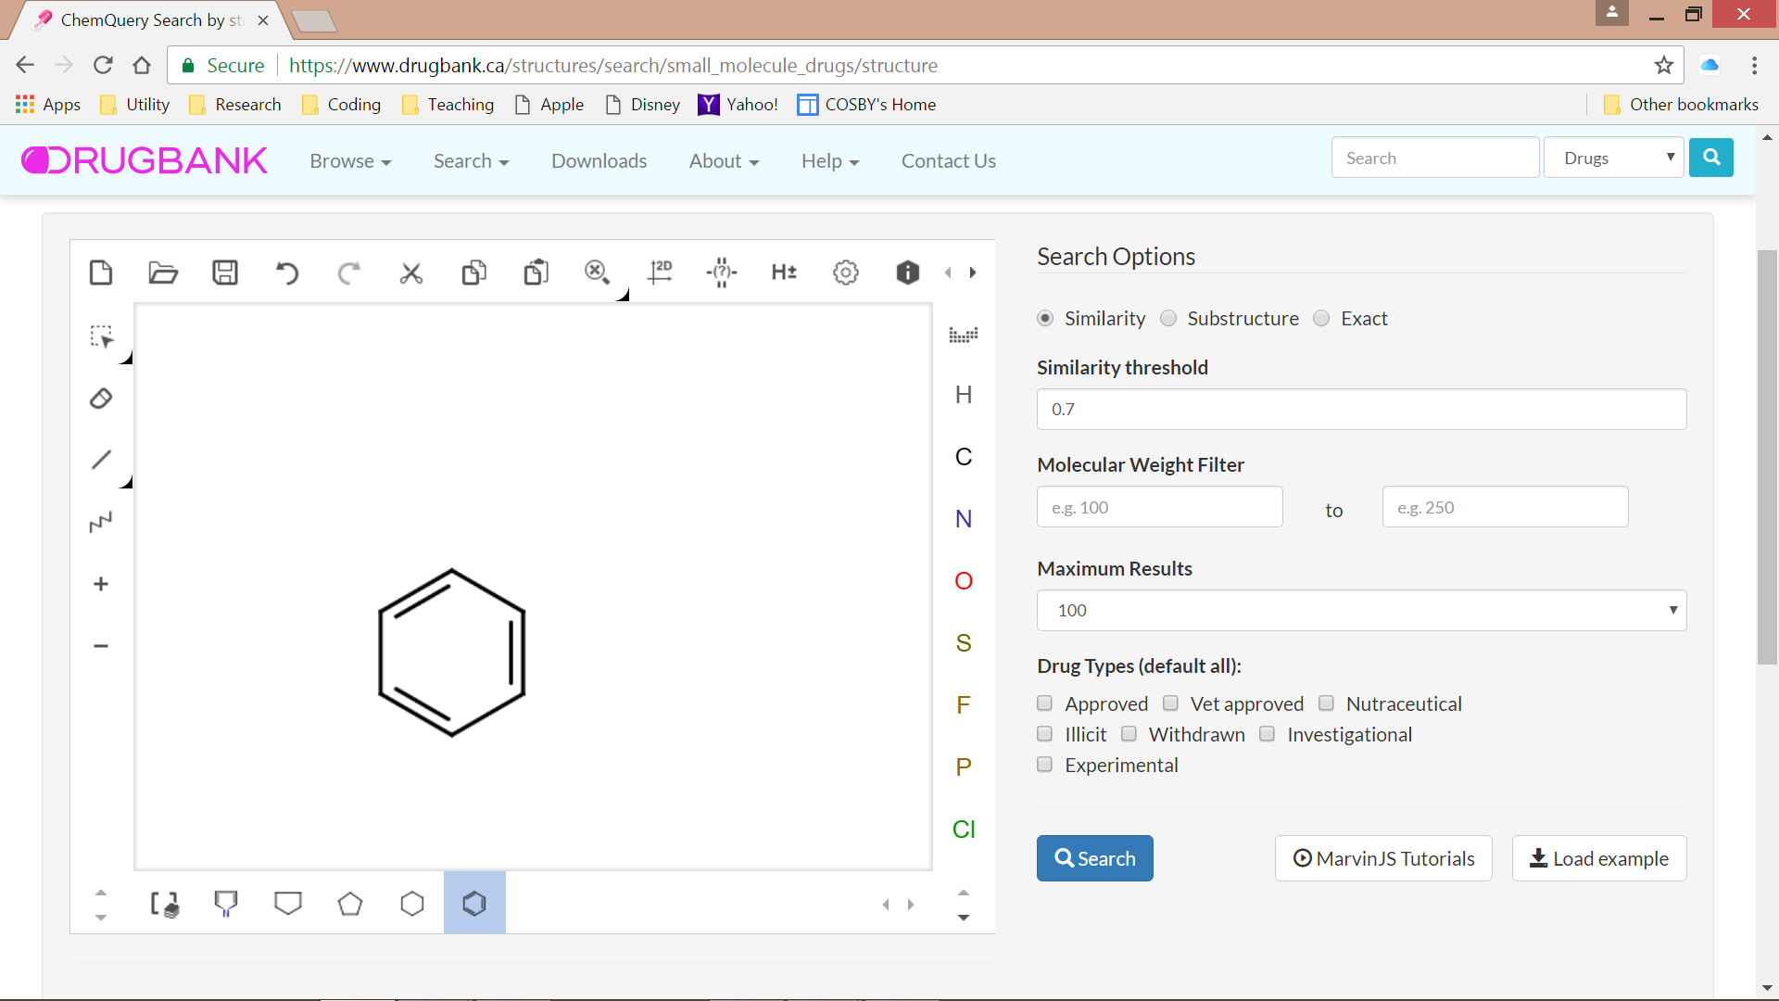
Manual Visual Graph Query Interfaces

Slide 19
Manual Visual Graph Query Interfaces

Slide 20


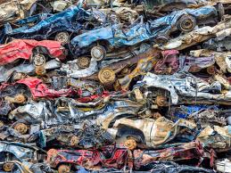

Classical Approach of Construction
Social Net
Chemical compounds
Hardcoded labels, patterns
Limited variety
Manual maintenance
Not portable

Slide 21

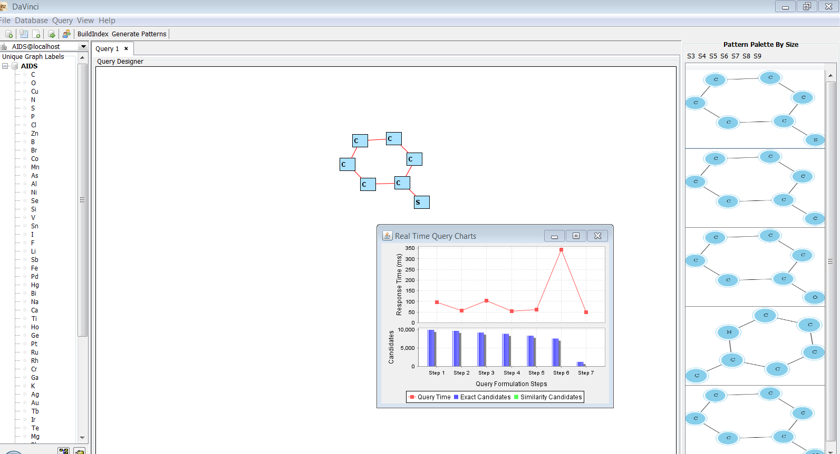

Data-driven Visual Interface Construction & Maintenance
Graph Repository
Diverse content
Portable
Auto maintenance

Slide 22
Data-driven Construction
Content selection
Which patterns should be in the palette?
Formulate query easily and faster
Give shortcuts
Issues
Size of the palette
Maximally covers the DB
Minimal redundancy among patterns
Aesthetics-aware

Slide 23
Data-driven Maintenance
Content Maintenance
How do we maintain the labels and patterns as underlying data changes?
Issues
Real-time maintenance
Batch vs Incremental
Enhance usability (gain in coverage and reduction in redundancy)
Leverage usage patterns and query workload (if available)

Slide 24

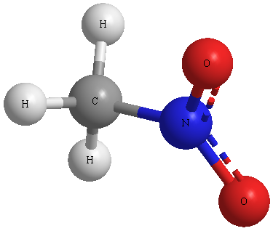
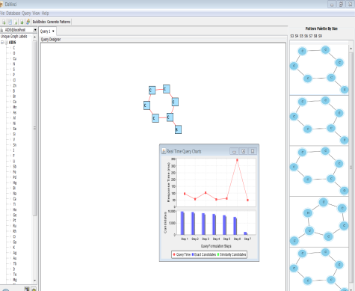

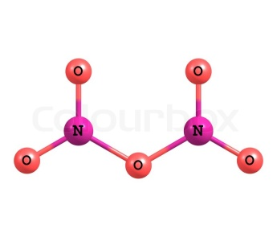

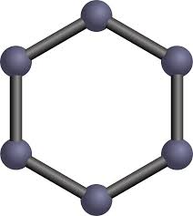
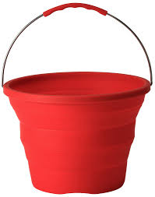



DAVINCI: Initial Effort [ICDE 15, VLDB 16]
Online
Canned
patterns
Closure graphs
Offline
GraphDB
C
C
C
C
C
Graph set clustering
Closure graph set generation
Large set of small/medium sized graphs
Topologically-similar partitions

Slide 25
Visual Graph Query Formulation & Guidance
Next

Slide 26
Opportune Query Feedback
Modeling feedback
An alert or notification for a secondary task when a user is working on a primary task
Efficient detection algorithm
Immediate notification
Cognitive impact on users doesn’t matter!
Needs
Detect efficiently
Notify opportunely
Ineffective to notify at the end of query formulation
Delivering notifications inopportunely can negatively impact task completion time, lead to more errors, and increase user frustration.

Slide 27
When to notify?
Breakpoint
Reduction of Interruption cost and frustration
React faster to notifications
Task-relevant notifications should be delivered at Medium or Fine breakpoints
The moment of transition between two observable, meaningful units of task execution, and reflects a change in perception or action [Newton, 1973]
Coarse, Medium, and Fine
Best moment to interrupt a user is on breakpoints between tasks [Iqbal & Bailey, CHI 2008]
Defer the notification to appear in the next breakpoint
Adopt defer-to-breakpoint-based strategy for interrupting query formulation tasks

Slide 28
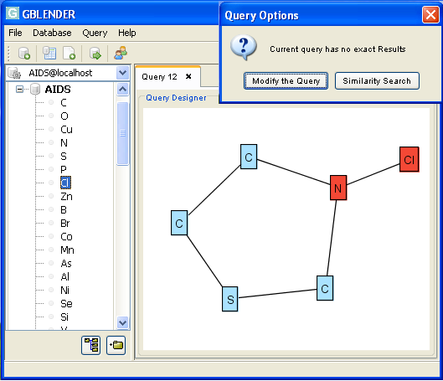
Modeling Optimal Notification Time
Deliver notification before the construction of the succeeding query condition is finished (Optimal breakpoints)
Fine
Fine
How do we estimate the time available for deliver of notification at optimal breakpoint?

Slide 29
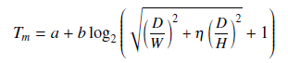
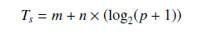
HCI-Inspired Quantitative Model
[Accott & Zhai, CHI 03]
T_{m}
T_{s}
[Ahlstrom, CHI 05]
0 < T_{opt} <T_{m} + T_{s}

Slide 30

The iSERF Framework
Cursor moving towards Schema Panel
Compute movement time T_{m} Suspend notification by T_{m} time
Cursor in Schema Panel
Compute selection time T_{s} Suspend notification by T_{s} time for item to be selected
Interruption-Sensitive Notification Module
Notification delivery
Deliver appropriate notification identifying condition(s) for empty result
Empty Result Detection Module

Slide 31
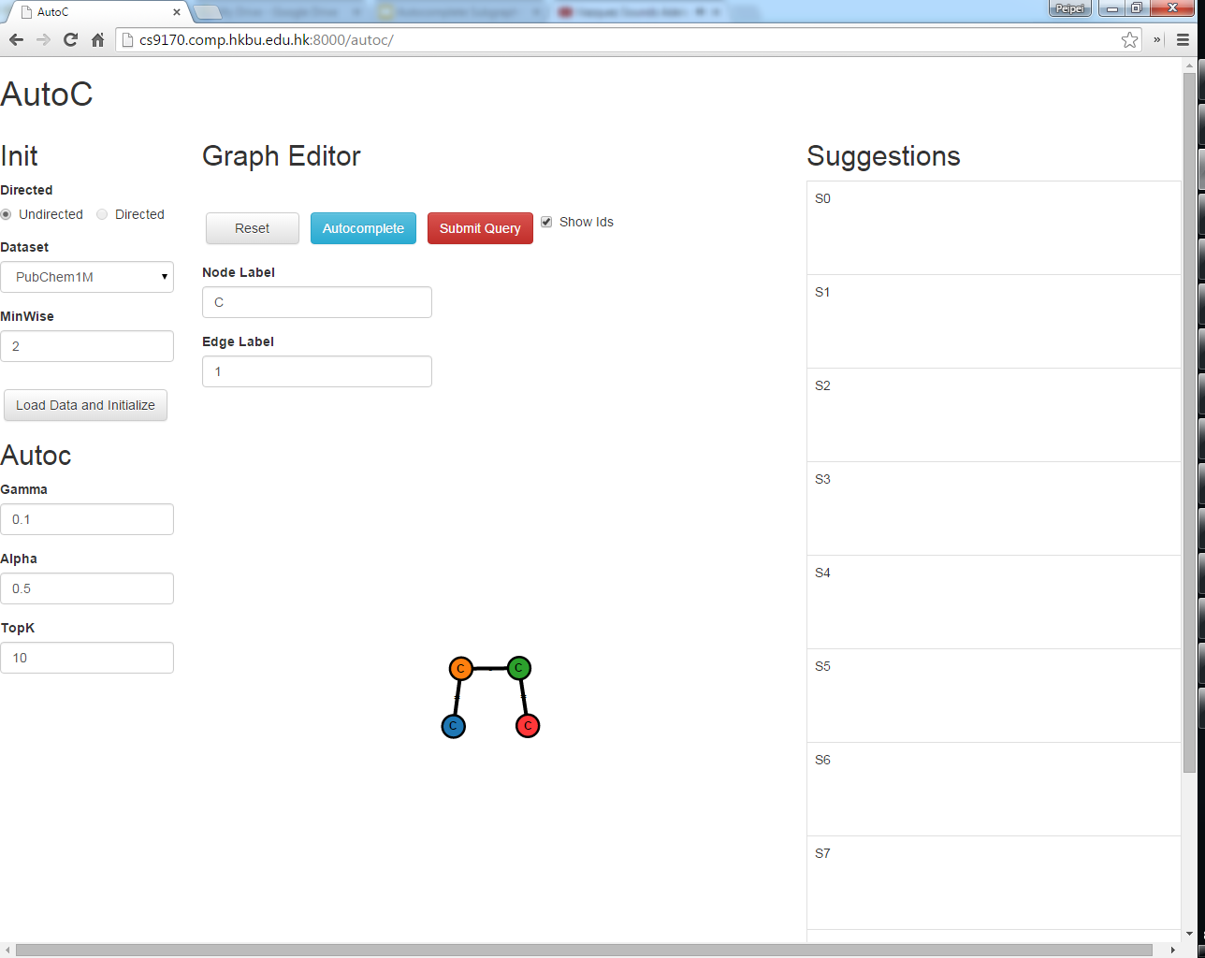
Query Autocompletion Demo
http://www.comp.hkbu.edu.hk/~csppyi/autog/

Slide 32
Autocompletion Comparisons
 | Keyword Search | Visual Graph Query
User Action | keystroke | drag
Atom Unit | char: 'a', 'b', 'c', ... | edge: C-C, C=C, ...
Logical Unit | keyword: "world", "clock", ... | undefined
Query | concatenated keywords | undefined
 | "world clock", "world cup", ... | C=C-C=C-C=C, ...

Slide 33
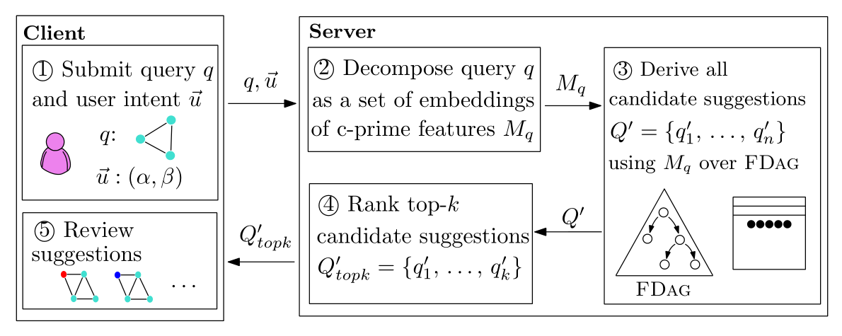
The AutoG Framework

Slide 34
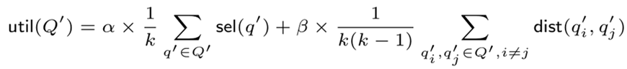
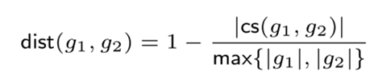
User Preference / Intent
User intent value of a query (suggestion) set
(MCCS) Distance between two graph suggestions
Property: util is submodular → greedy

Slide 35
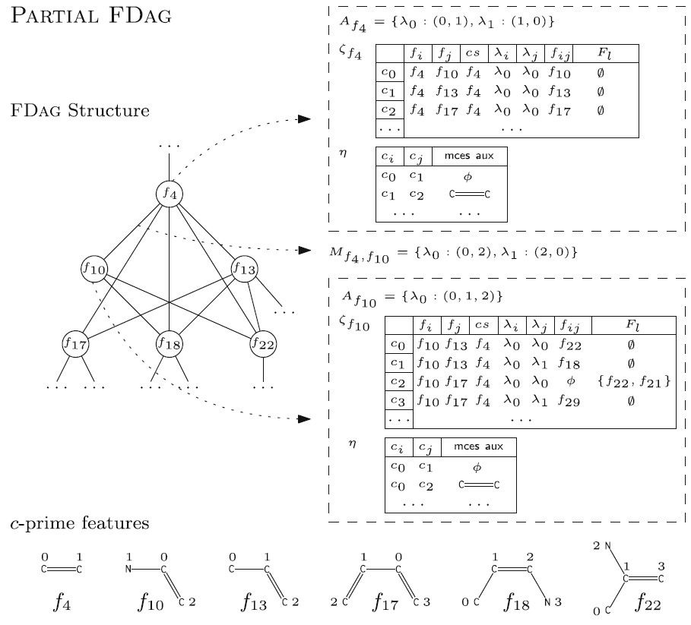
Optimizations
The FDAG index
Index c-Prime features and their pairwise compositions Prune automorphic suggestions (redundant suggestions) early
Online ranking
Approximate selectivities of query suggestions Prune empty suggestions early Optimize diversity computation trimming the common parts between suggestions

Slide 36

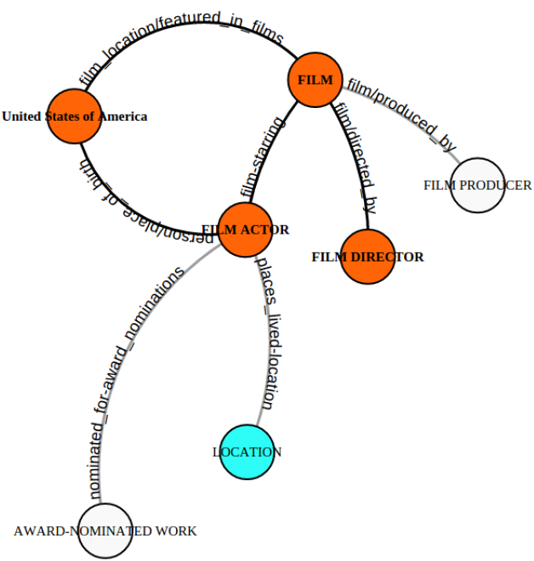
Orion
Overview
Interactive visual query builder with suggestions Iteratively suggest edges based on their relevance to the user’s query intent, according to the partial query graph so far Edge ranking: query-specific random decision paths The use of statistics based on data graph, query logs, and so on.
Suggestions: Grey nodes/edges
Accepted by users: Positive edges (become blue) Reject or ignored by users: Negative edges
User’s intent can be derived from these edges

Slide 37
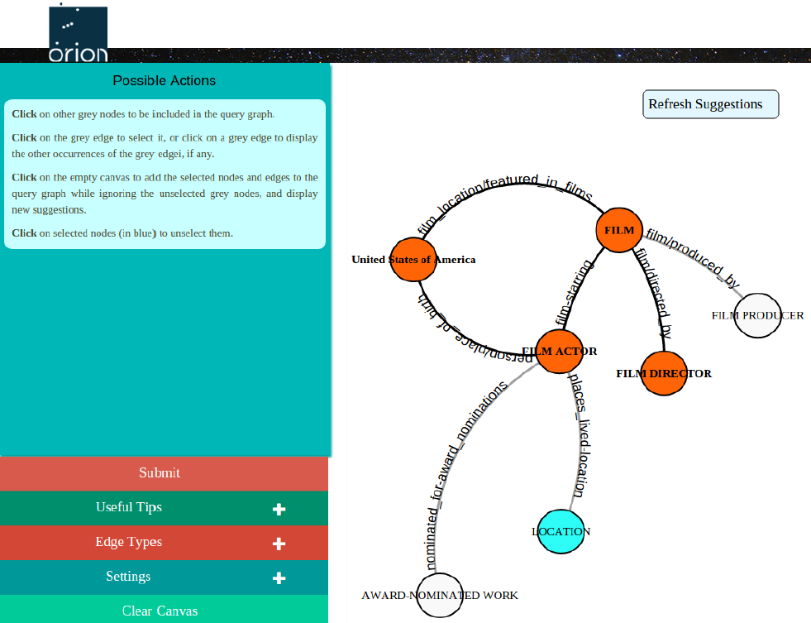
Orion GUI
Dynamic list of all possible user actions at any given moment
Control panel for various settings and tips

Slide 38


Orion Implementation
Prototype
http://idir.uta.edu/orion
Video Introduction
http://bit.ly/2pShvrm

Slide 39
Visual Action-aware Graph Query Processing
Next

Slide 40
Subgraph Queries
Subgraph Containment
Given a graph DB D and a query graph Q, find all data graphs in D in which Q is a subgraph
Subgraph isomorphism from Q to G ∈D
Subgraph Similarity
Data graphs that “approximately” contain the query graph
Use subgraph distance based on maximum connected common subgraph (MCCS)
C
C
C
C
C
C
Cl
C
C
C
C
C
C
C
C
C
C
N

Slide 41
Classical Visual Querying Paradigm
40+ years old query paradigm!
GraphDB
Query formulation
Query processing
C
C
Large collection
of small graphs
time
HCI
DB
C
C
C

Slide 42
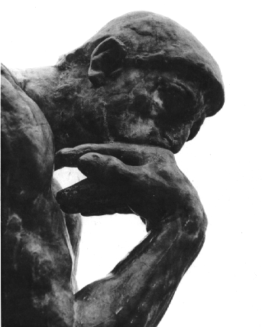
Visual Graph Query Formulation Meets Query Processing
Rethink the classical query paradigm
Why wait for the complete visual query to be constructed before initiating query evaluation? How can we blend these two steps?
By initiating query processing “early”, can we significantly reduce the system response time?
Query formulation
Query processing
time

Slide 43
Non-traditional Challenges
Partial query-aware indexing schemes
Materialization of intermediate results
Selectivity-free query processing
Focus on waiting time of users
“Computing time (power) is getting cheaper but users’ time isn’t..”

Slide 44

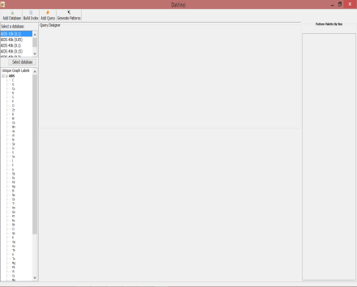
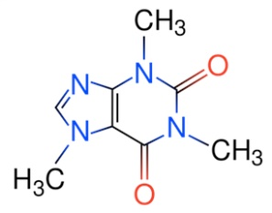


Overview of VOGUE [SIGMOD 10, ICDE 12, CIDR 13]
Online
Subgraph isomorphism test (extension of VF2)
1
1
C
C
2
C
C
SPIG
SPIG
C
Candidate graph ids
Candidate graph ids
Offline
DF-Index
MF-Index
GraphDB
C
C
A fragment g is frequent
if its support is no less than α|D|
C
C
C
Frequent subgraph
Miner (gSpan)
|g|=1 or all subgraphs are frequent
A2I Index (DIFs)

Slide 45
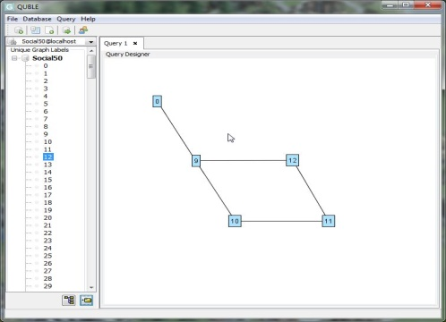
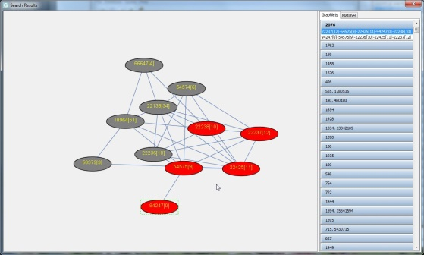
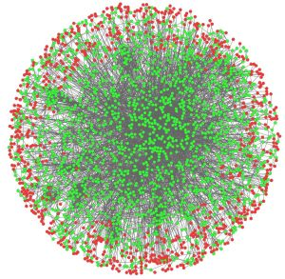
QUBLE: Extension to Large Graphs [VLDB J 14]
Online
G-SPIG
Supergraphlet-at-a-time
Frequent
fragments
Offline
Graph Partitioning
(METIS)
Graphlets
(Partition graphs, bridges)
A2F-Index
|g|=1 or |g| = 2 and is an maximal cover graph
(SIF)
A2I Index

Slide 46

Performance Summary
Outperforms traditional approaches in terms of waiting time
Not significantly impacted by query formulation sequence
Works well with small-sized queries
LASER: Newer version can handle large query graphs and scales to more than million data graphs (10X more than state-of-the-art)!

Slide 47


Challenges for Performance Study
Large-scale performance study
Traditional approach
Randomly extract subgraphs of different size and execute them
Doesn’t work in this paradigm!
Why?
Queries need to be visually constructed by users
GUI latency is critical for performance study
Challenge
Users are expensive! How do we simulate visual query formulation?

Slide 48

VISUAL [ICDE 15, TKDE 17]
C3: Visual Subgraph Query Simulator
Test
queries
Model
C1: Test Subgraph Query Generator
C2: Quantitative Model of Query Formulation
Data
graphs
Graph Repository
Index

Slide 49
Quantitative Model for Query Formulation Time
T(s)
[Accott & Zhai, CHI 03]
T(m)
[Cockburn et al, HCI 09]
T(e)
T(d)
T(m) + T(s) + T(d) + T(e)

Slide 50
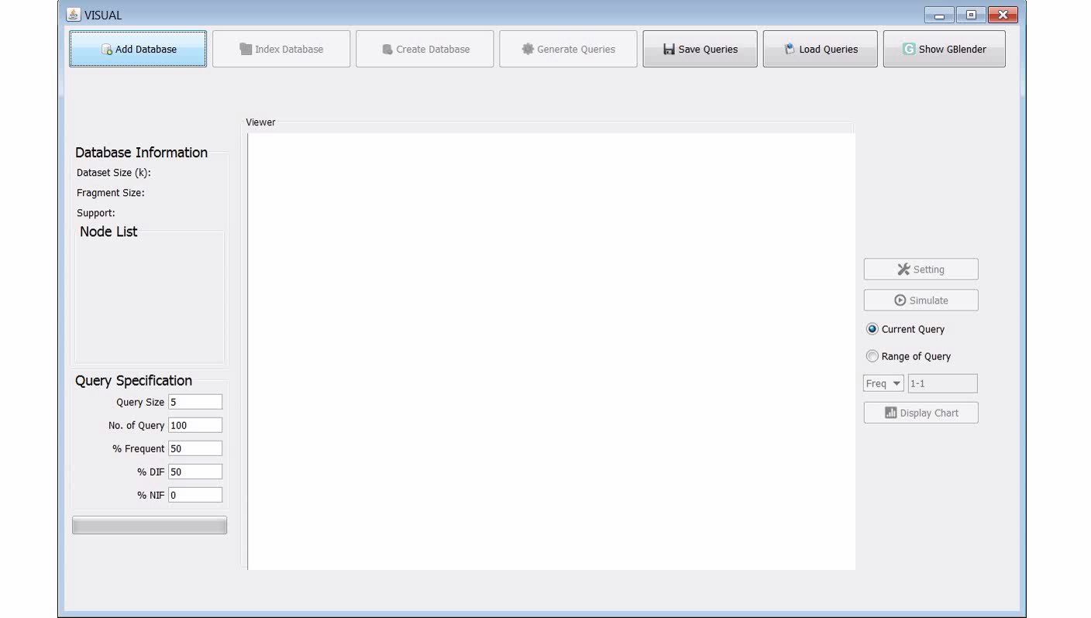
VISUAL Demo

Slide 51
Query Results Exploration & Visualization
Next

Slide 52
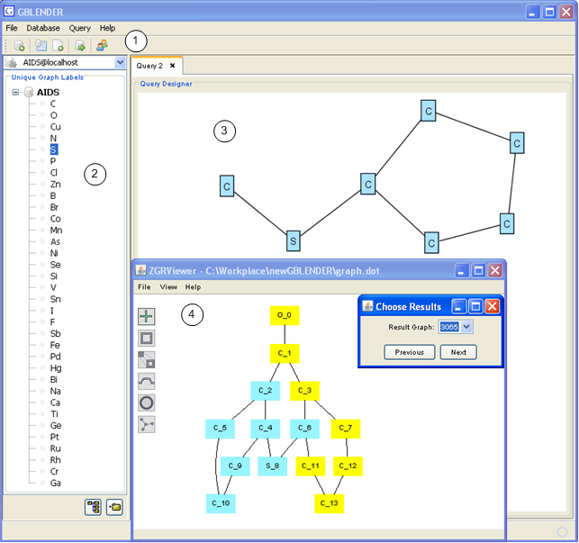
Query Results Exploration
Two Categories
Very few efforts! Large set of small graphs vs large networks
Large set of small graphs
Typically a decision problem
Highlight a subgraph that matches the query
[SIGMOD 10, ICDE 12]

Slide 53
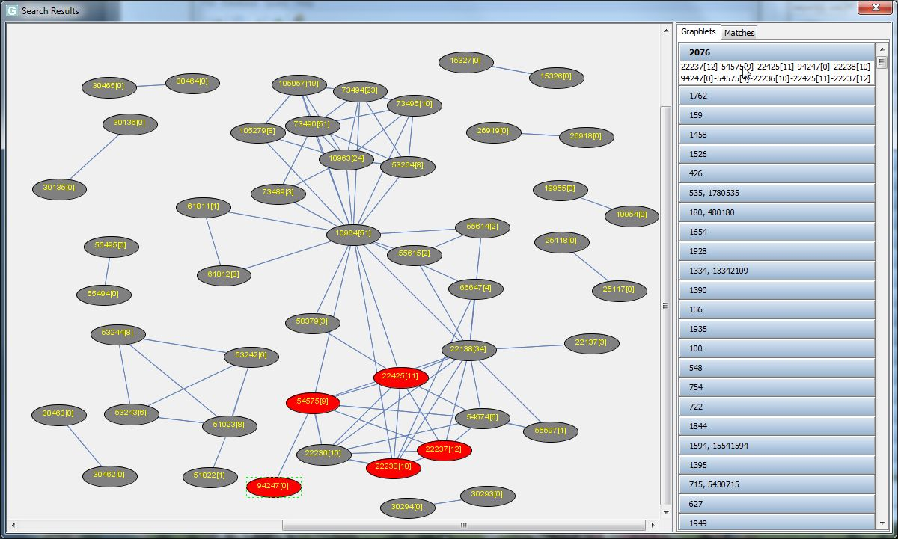
Query Results Exploration
Large Networks
Summarization-based (SLQ [SIGMOD 14])
Supergraphlet-at-a-time (QUBLE [VLDBJ 14, SIGMOD 13])
Feature-based (R2DB [ICDE 12])
Supergraphlet-at-a-time
Summarization-based

Slide 54
Conclusions
Next

Slide 55
Bridging Usability, Performance, Functionality
Software
Usability
Functionality
Performance
Visual query
interface
Query
response time
Query feedback,
Exploratory search
HumanDB

Slide 56
Shifting Traditions
1990-2015: Visual query interfaces are constructed manually
2015: Automatic, data-driven construction of visual graph query interface
1970s-2005s: Query Formulation Query Processing
2006s: Visual query form. Query Processing
1990s - 2015: Visual query performances are carried out manually
2015: Automated query construction and performance benchmarking

Slide 57
Open Research Problems
More complex graph queries: Homomorphism-based queries, multi-attribute queries, graph simulation
Visually querying massive graphs
How can we extend data-driven GUI construction to be aesthetics-aware?
Multi-faceted exploration and visualization of query results
HCI-awareness with other types of data?

Slide 58

Final Words
HCI-aware Data Management
Towards usable data management systems
Making visual query interface design data-driven
Making query formulation & processing HCI-driven
Novel area of research
Multi-disciplinary effort:
Data management
HCI
Cognitive psychology
Broad goal
Stimulating a cultural shift in our thinking by HCI, cognitive psychology and data management to “work” together

Slide 59

Thank You!

